Slide 1
Final Presentation
Resilient Control For Smart Grid
Notes:
Good morning everyone. This is our final presentation for our project. We are group 11, and our topic of our project is resilient control for smart grid.

Slide 2

Group 11
Akanksha Kale
(SBU ID: 113788594)
Akhila Juturu
(SBU ID: 114777498)
Mandar Mahajan
(SBU ID: 113276053)
Notes:
My team members are I, Mandar, Akanksha and Akhila. In today’s presentation, I will first present our goals, deliverables and our progress in achieving them. Then I’ll give a quick review of our project timeline. Lastly, and most importantly, I will present the key results that we achieved in our project.

Slide 3
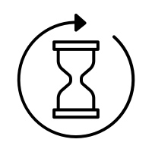
Goals/Deliverables
Goal # | Description | Outcome
1 | Perform a case study on the 2021 Texas power grid failure | Identified factors that caused the blackout and possible preventive measures
2 | Literature Survey of existing implementations | Identified a paper and studied the implementation
3 | Understand implemented methodology and improve the existing model | Implemented corrective measures and performed ‘what-if’ analyses
4 | Write a detailed report on the project | In Progress
Notes:
Let’s have a look at our goals. As the first phase our project, we had performed a case study on the 2021 Texas power grid failure. This gave us a background of how smart grids get affected by hazards if they are not weather resilient.
Next, we performed a literature survey and identified a paper: “An Open-source Extendable Model and Corrective Measure Assessment of the 2021 Texas Power Outage”. This paper gives an open-source simulation model for the Texas 2021 power failure. We studied the paper to understand the methodologies used by the authors and then implemented certain corrective measures as part of different ‘what-if’ analyses.
Right now, we have started writing the report and aim to complete it by next week.

Slide 4
Project Timeline
Week 15
Week 13,14
Week 11,12
Week 10
Week 9
Week 8
Study existing literature and implementations
Project Proposal
Case Study on Texas Power Grid Failure
Study Simulated model
Implement Corrective Measures
Project Report
Notes:
This is a summary of our timeline. We gave the project proposal in week 8 and spent time reviewing literature during week 9. We found the Texas power failure simulation paper during this week. We performed the case study during week 10. Then, we spent weeks 11 through 14 studying the paper and trying to implement corrective measures in the simulations.

Slide 5
Project overview
Main result of the paper: Open-source simulation model of the 2021 Texas power grid failure
Our results: Implementing corrective measures suggested in the paper and running simulations to see if load shedding decreases
Notes:
Next, I will give a short overview of our project. The paper that we were studying gives a model that simulates the 2021 Texas power grid failure. In our project, we wanted to assess different corrective measures that would make the smart grid more resilient, thereby reducing the load shedding in case of a power failure. To this end, we implemented certain corrective measures as part of the simulation code, and then ran the simulations as part of ‘what-if’ analyses to see if load shedding would decrease if certain corrective measures had been implemented.

Slide 6
Simulation of Power Failure
Solves a DCOPF equation to see if it is possible to meet current demand.
If no feasible solution is possible, scenario is considered as “Energy-Not-Served”
Notes:
I will give a very brief overview of the simulation model. So the model uses available energy generation data to form a DC Optimal Power Flow equation, and then attempts to solve the equation. This is a little bit similar to what we studied in assignment 2 where we set and solved convex optimization equations, so our experience helped us better understand the author’s simulation model. If a feasible solution is not possible, load shedding is increased as energy demand would not be served.
We will go into more details about the simulation model in the report.

Slide 7
Key Results
Notes:
Next, let’s look at what results we were able to achieve.

Slide 8
Model fidelity
1
Notes:
Before trying out corrective measures, we tried out the base simulation model given by the authors without adding any corrective measures. We did this to ensure that the simulation model is able replicate the power failure event with reasonable accuracy.

Slide 9
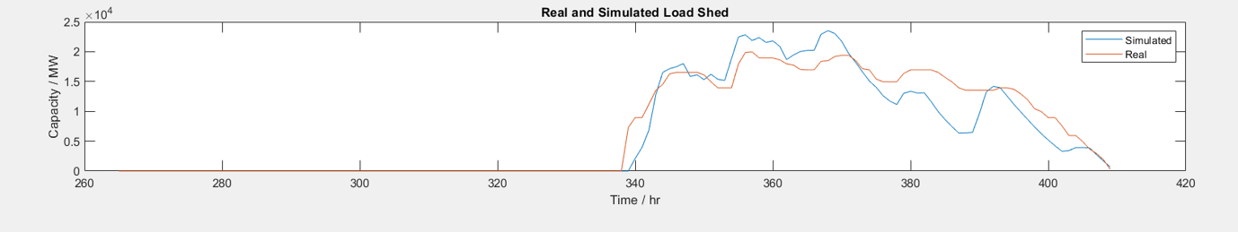
Model fidelity
Simulated load shed
920.51 GWh
Actual load shed
944.04 GWh
Notes:
For each of our simulation results, we compare the simulated load shedding and the real load shedding. For the replication result, we see that the simulated load shedding tracks the real load shedding quite closely.
Total load shedding via the simulation is 920 GWh, whereas the actual load shed was 944 GWh. We see that the model given by authors is able to simulate the Texas power failure event with reasonable error.

Slide 10
Winterization Schemes
2
Notes:
The first corrective measure that we tried out was winterization of equipment. This was modelled as extra available energy for the power plants that actually went down during the power failure event.

Slide 11
Generation Sources
Wind
Coal
Natural Gas
Nuclear
01
03
02
04
Notes:
In Texas, energy generation sources come from mainly the following sources: wind, coal, natural gas and nuclear. We added winterization values for wind, coal and natural gas separately to see which energy source benefits the most from winterization.

Slide 12
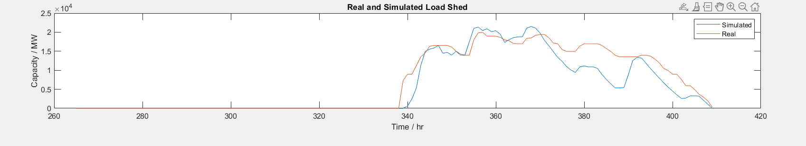
Findings
Coal
Simulated load shed
829.90 GWh
Reduced load shed
99.74 GWh
Notes:
For coal, we can see that winterization decreased the load shedding, however not by very much. Load shedding was reduced by 99.74 GWh.

Slide 13
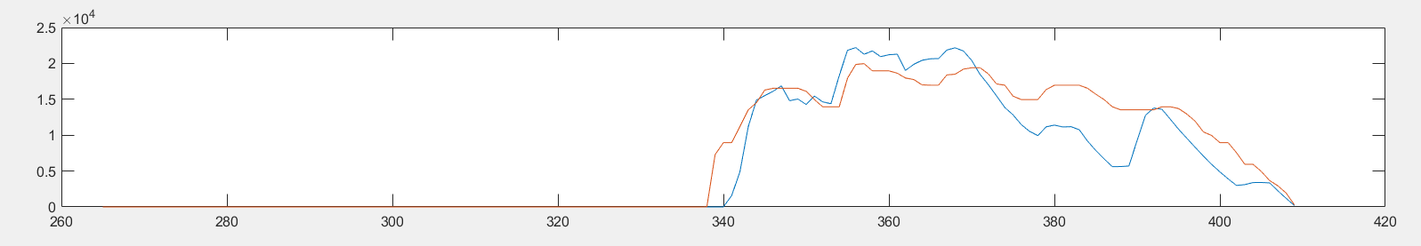
Findings
Wind
Simulated load shed
863.26 GWh
Reduced load shed
66.3 GWh
Notes:
For wind energy, we see even lesser improvement. Load shedding was reduced by just 66.38 GWh.

Slide 14
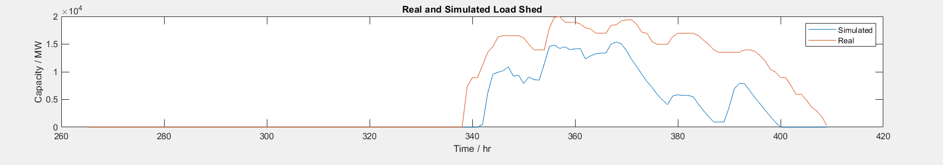
Findings
Natural gas
Simulated load shed
535.02 GWh
Reduced load shed
394.62 GWh
Notes:
For natural gas, we see a very significant decrease in simulated load shedding. Load shedding was reduced by a huge amount of 394.62 GWh. Clearly, looking at these figures, winterization of natural gas equipment would have significantly reduced the outages in the Texas failure. We can reason about this improvement because natural gas generators are the most susceptible to winter hazards compared to other energy sources. Considering this, it feels natural that winterization of natural gas plants would cause a notable decrease in load shedding.

Slide 15
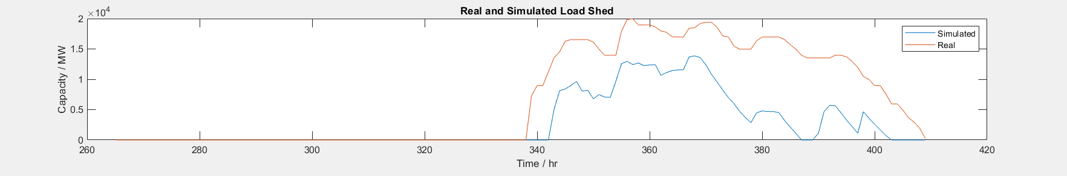
Findings
Combined winterization of all sources
Simulated load shed
345.97 GWh
Reduced load shed
583.67 GWh
Notes:
Next, we combined winterization for all the sources and ran the simulation. As expected, we see a huge decrease in the load shedding amount. It reduced by a large amount of 583 GWh compared to real load shedding. From this, we can infer that that more than 60% of outages could have been avoided if the wind, coal and natural gas power plants were properly winterized.

Slide 16
3
Demand Response
Notes:
Demand response was another suggested corrective measure which we tried out. A demand response program is nothing but a prior agreement between energy suppliers and consumers of a voluntary reduction in load in case of an emergency. In the simulation, demand response was modelled simply by excluding counting a certain amount of missed energy demand under the “Energy-not-served” metric.

Slide 17
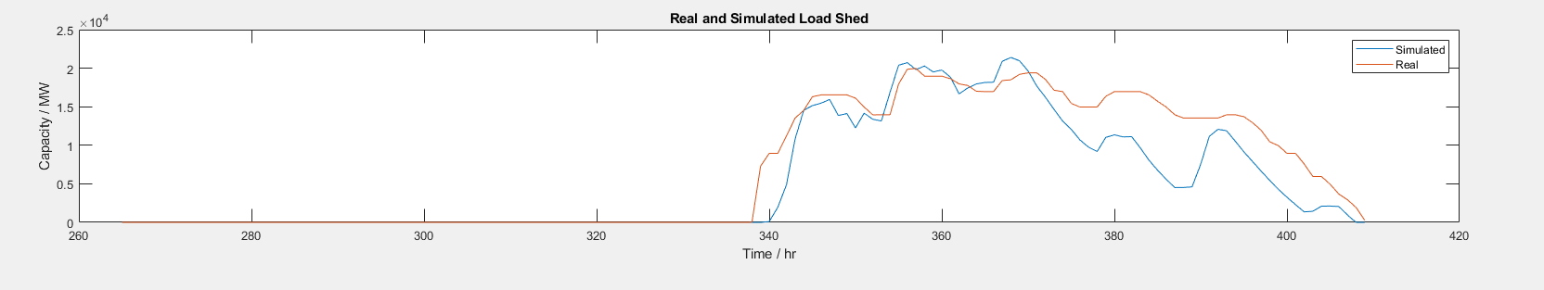
Findings
Demand response energy capacity: 1 GW
Simulated load shed
781.22 GWh
Reduced load shed
148.42 GWh
Notes:
We used 1GW as the demand response energy capacity to run this simulation.
Apart from these, we tried two more corrective measures: adding direct current ties to the existing network, and adding energy storage reserve capacity. Due to the time constraint, we cannot present them now. However we will include a detailed write-up about them in the report.

Slide 18
References
Wu et. al. (2020). An Open-source Extendable Model and Corrective Measure Assessment of the 2021 Texas Power Outage.

Slide 19
Thanks!

